Slide 1
PROJECT PARTNERS
HARRIS BAIG (FA20-BCS-052)
HASSAN MUNAWAR (FA20-BCS-056)

Slide 2

MOVIE RECOMMENDATION SYSTEM

Slide 3
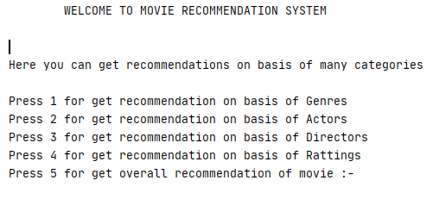
INTRODUCTION
Our project will recommend movies on the following features of a movie:
Genres
Actors and Cast
Directors
Ratings
Overall recommendation on each feature of movie

Slide 4
libraries
Pandas ( For importing data from excel sheet and data cleansing)
Difflib ( For getting the best match of input movie name)
Tfidfvectorizer from sklearn (For converting strings into vectors)
cosine similarity from sklearn ( For calculating similarity between two movie vectors)

Slide 5
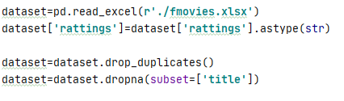

Data cleaning

Slide 6

Approach
TfidfVectorizer :
Transforms text to feature vectors that can be used as input to estimator. It converts each word to feature index in the matrix, each unique word gets a feature index. tf is the number of times a term appears in a particular document.
tf(t) = No. of times term ‘t’ occurs in a document

Slide 7
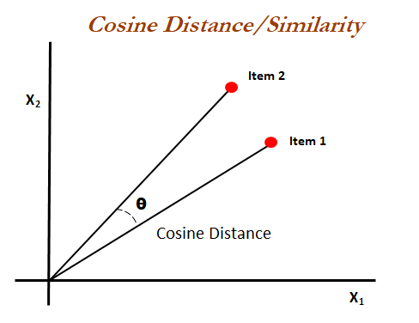
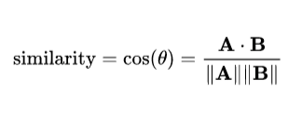
Approach
Cosine-Similarity:
Cosine similarity is a measure of similarity between two vectors. It is use to calculate cosine of the angle between them. Cosine similarity then gives a useful measure of how similar two movies are likely to be in terms of their combined features.

Slide 8
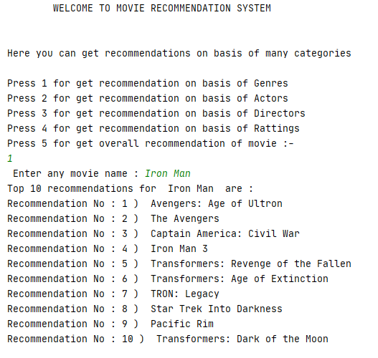
Output of recommendation

Slide 9


